Slide 1
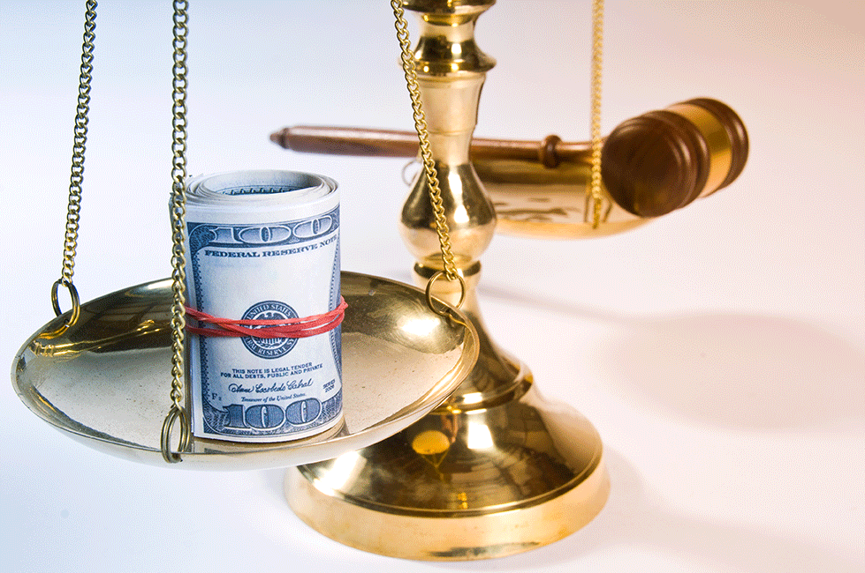
Pretrial Incarceration
And the Money Bail System

Slide 2
What is Pretrial Incarceration?
What is a bond?
What types of bonds are there?
Written Promise to Appear
Custody Release
Unsecured Bond
Secured Bond

Slide 3
Arrest
Case Disposition
By Trial, Plea, or Dismissal
First Appearance
(Bond Adjusted)
Magistrate Sets
First Bond
Sentence
(If Conviction)
Bond Motion
Pretrial

Slide 4
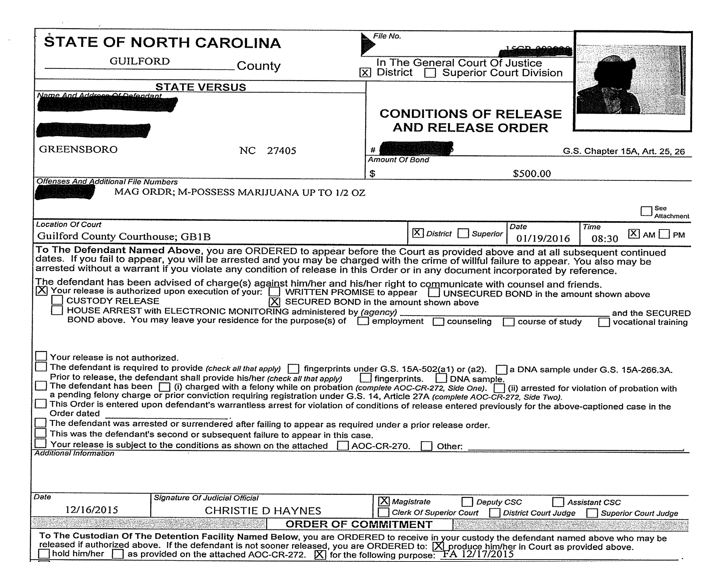

Slide 5
Pretrial Release in North Carolina N.C. Gen. Stat. 15A-534
15A-534. Procedure for determining conditions of pretrial release (a) In determining conditions of pretrial release a judicial official must impose at least one of the following conditions: (1) Release the defendant on his written promise to appear. (2) Release the defendant upon his execution of an unsecured appearance bond in an amount specified by the judicial official. (3) Place the defendant in the custody of a designated person or organization agreeing to supervise him. (4) Require the execution of an appearance bond in a specified amount secured by a cash deposit of the full amount of the bond, by a mortgage pursuant to G.S. 58-74-5, or by at least one solvent surety. (5) House arrest with electronic monitoring.

Slide 6
What purpose does a bail bond serve?

Slide 7
Pretrial Release in North Carolina N.C. Gen. Stat. 15A-534
(b) The judicial official in granting pretrial release must impose condition (1), (2), or (3) in subsection (a) above unless he determines that such release will not reasonably assure the appearance of the defendant as required; will pose a danger of injury to any person; or is likely to result in destruction of evidence, subornation of perjury, or intimidation of potential witnesses.

Slide 8
Pretrial Release in North Carolina N.C. Gen. Stat. 15A-534
(c) In determining which conditions of release to impose, the judicial official must, on the basis of available information, take into account the nature and circumstances of the offense charged; the weight of the evidence against the defendant; the defendant's family ties, employment, financial resources, character, and mental condition; whether the defendant is intoxicated to such a degree that he would be endangered by being released without supervision; the length of his residence in the community; his record of convictions; his history of flight to avoid prosecution or failure to appear at court proceedings; and any other evidence relevant to the issue of pretrial release.

Slide 10
Bail Hypothetical #1
Banks calls police to report an employee shot during a robbery in progress. Three minutes later, police stop a suspect running from the same bank with a gun in his hand and a bag of money. He lives in California, but was visiting his brother for a week during his wedding when the alleged robbery took pace.
What kind of bond would you set? Why?
Secured?
Unsecured?
House Arrest?
Written Promise to Appear?
Considerations: Risk of failure to appear; risk of danger of injury to any person; risk of
destruction of evidence, subornation of perjury, or intimidation of potential witnesses.

Slide 11
Bail Hypothetical #2
Police respond to call of domestic violence. Wife is observed with multiple injuries and claims husband hit her. Husband claims that Wife attacked him first. Husband is arrested and at the jail, the magistrate is informed that this is the fifth time Husband has been arrested on charges of domestic assault in last 3 months and none of the previous charges have gone to trial yet. Defendant has bonded out all four previous times.
What kind of bond would you set? Why?
Secured?
Unsecured?
House Arrest?
Written Promise to Appear?
Considerations: Risk of failure to appear; risk of danger of injury to any person; risk of
destruction of evidence, subornation of perjury, or intimidation of potential witnesses.

Slide 12
Bail Hypothetical #3
Police respond to call of domestic violence. Wife is observed with no injuries and claims husband hit her. Police do not take out charges and leave. Wife then goes to magistrate and swears out a warrant and Husband is arrested the next day. At the jail, the magistrate is informed that this is the fifth time Wife has taken out charges and all of them have been dismissed.
What kind of bond would you set? Why?
Secured?
Unsecured?
House Arrest?
Written Promise to Appear?
Considerations: Risk of failure to appear; risk of danger of injury to any person; risk of
destruction of evidence, subornation of perjury, or intimidation of potential witnesses.

Slide 13
Bail Hypothetical #4
Car is stopped by police for broken tail light. Officer gets consent to search the car from the driver and finds 3 grams of marijuana in a locked glove compartment. Four people are in the car and all deny knowledge of the marijuana. All four are charged with simple possession, a class three misdemeanor. All occupants are students at a local Greensboro high school.
What kind of bond would you set back passengers? Driver? Why?
Secured?
Unsecured?
House Arrest?
Written Promise to Appear?
Considerations: Risk of failure to appear; risk of danger of injury to any person; risk of
destruction of evidence, subornation of perjury, or intimidation of potential witnesses.

Slide 14
The time spent in jail awaiting trial has a detrimental impact on the individual. It often means loss of a job; it disrupts family life; and it enforces idleness. Most jails offer little or no recreational or rehabilitative programs. The time spent in jail is simply dead time. Moreover, if a defendant is locked up, he is hindered in his ability to gather evidence, contact witnesses, or otherwise prepare his defense. Imposing those consequences on anyone who has not yet been convicted is serious. It is especially unfortunate to impose them on those persons who are ultimately found to be innocent.
Barker v. Wingo, 407 U.S. 514, 532-533 (1972)

Slide 15
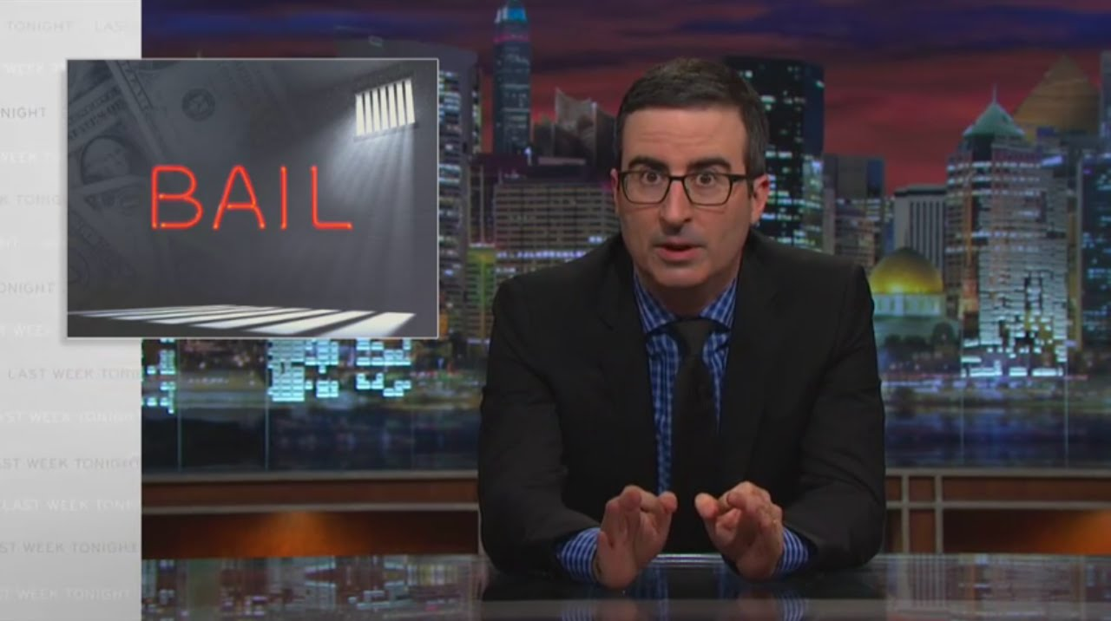
Potential Problems with the Bail System
https://www.youtube.com/watch?v=IS5mwymTIJU
0’00’’ – 6’20’’

Slide 16
Do bonds serve the purpose they are intended to?
Is the world safer when a billionaire bonds out of jail on a pending murder charge than it is when a poor person does?
The financial incentive behind a bond is that you get that money back when the case is over. Is that incentive still present when a poorer person gives 15% to a bondsman (who then posts the rest for them) that he will never get back?
Are there any alternatives?

Slide 17
Links between Pretrial Incarceration and Case Outcomes
78% of defendants detained pretrial- contrasted with 60% of defendants released pretrial- are ultimately convicted.¹
Pretrial detainees are more likely to plead guilty, be convicted of a felony, receive a sentence of incarceration, and receive longer sentences compared with people who are released pretrial.²
¹ Thomas H Cohen & Brian Reaves, Bureau of Justice Statistics, State Court Processing
Statistics, 1990-2004: Pretrial Release of Felony Defendants in State Courts 7 (2008).
² Gerard Rainville & Brian Reaves, Bureau of Justice Statistics, Felony Defendants in Large
Urban Counties, 2000 & Table 24 (2003).

Slide 18
Potential Solutions to the Bail System
https://youtu.be/IS5mwymTIJU?t=648
11’29 – 17’49’’

Slide 19
Strategizing a Bond Motion
Considerations Relevant to Setting Bond
Risk of Danger to the Community
Risk of Flight
Other Considerations
“Free Discovery”
Time Constraints

Slide 20
Interviewing a Defendant or Witness for a Bond Motion
nature and circumstances of the offense charged;
the weight of the evidence against the defendant;
the defendant's family ties, employment, financial resources, character, and mental condition;
whether the defendant is intoxicated to such a degree that he would be endangered by being released without supervision;
the length of his residence in the community;
his record of convictions;
his history of flight to avoid prosecution or failure to appear at court proceedings; and,
any other evidence relevant to the issue of pretrial release

Slide 21
Obtaining a Consent Bond Order
Both a Motion (to which the DA has consented) and Order for the reduction or modifications of the conditions of pretrial release
Requirements
Necessary case and bond info (including requested bond)
Signature of the consenting District Attorney
Signature of a judge
Filed in the Clerk’s Office
Certified copy provided to the jail

Slide 22
Look at the example Consent Bond document in the Week 3 Resources and in the Digital Case File

Slide 23
Filing a Bond Motion
In-Court Motion asking judge to reduce the bond
State may oppose or remain silent
Requirements
Necessary case and bond info (including requested bond)
Served on District Attorney(‘s Office)
Filed in the Clerk’s Office
District Court: In Greensboro, must be filed no later than noon the day before the requested date of bond motion
Superior Court: District Attorney calendars the motion

Slide 24
Look at the example District Court and Superior Court Bond Motions i the Week 3 Resources and Digital Case File

Slide 25
What happens at the bond motion?
Judge will hear from the moving party (usually Defendant, through his or her attorney)
Judge will hear from the nonmoving party (usually the State)
Judge may hear from Court Services or other people present (witnesses, family, etc.)
Judge may
Deny the motion and leave the bond the same
Grant the motion and set the bond at the requested amount
Grant the motion but set the bond at a different amount
Deny the motion to reduce and, on the Court’s own motion, raise the bond
Impose additional conditions or strike existing conditions

Slide 26
Bond Motion Exercise

